Slide 1



Day 09
contact@anubhavtrainings.com
ABAP RESTFUL APPLICATION PROGRAMMING

Slide 2

Agenda – Day 09
OVP Continue…
KPI Modeler
Multi Dimension Modeling
Introduction to Java Script
What is Node JS
Writing JS Code
Initialize Node project
NPM – Node Package Manager
Sequence Diagram
Accessing Global Node Modules
Middleware

Slide 3
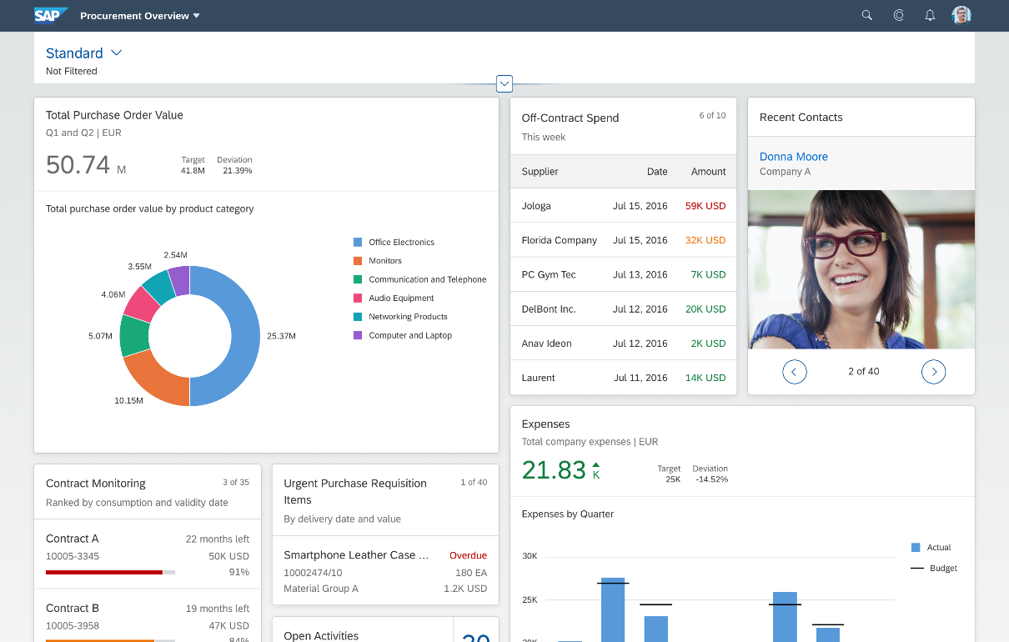
Working with Overview Page (OVP)
The overview page (OVP) is a data-driven SAP Fiori app type and floorplan that provides all the information a user needs in a single page, based on the user’s specific domain or role. It allows the user to focus on the most important tasks, and view, filter, and react to information quickly.
Each task or topic is represented by a card (or content container). The overview page acts as a UI framework for organizing multiple cards on a single page.
The overview page is based on SAP Fiori elements technology, and uses annotated views of app data, meaning that the app content can be tailored to the domain or role. Different types of card allow you to visualize information in an attractive and efficient way.

Slide 4
When to use OVP
You want to provide an entry-level view of content related to a specific domain or role.
Users needs to filter and react to information from at least two different applications to complete their role-specific tasks.
You want to offer different information formats (such as charts, lists, and tables) on a single page.
You plan to have at least three cards. These cards should not all be of the same type.

Slide 5
KPI Modeler
KPI modeler is a framework available in SAP S/4HANA, leverages the odata services and data models which are pre-delivered by SAP. It can be used to design powerful KPI reports to show analytics to the user in multi-dimension.
KPI Definition
(Measure)
Evaluation
(presentation)
1 … *
Drill Down reports
Controls to use Chart,table
1 … *
1 … 1
Data Source
Tile

Slide 6

Use Case
We are working in a manufacturing co. our co. is producing toys, we are delivering these toys via our own shipping channel. But when we have orders coming to us, we are packing and shipping them but we have complaints from buyers that orders are not reaching to them. Basically these supply chain it getting affected due to many reasons.
e.g.
Packaging damaged
Delay due to transport
Lockdown issue
…
My management wants to see all possible order issues (count) with the category of issues.
Also they want to see a tile with chart showing threshold values.
Also we want to allow filtering of these issues per category based on Sales Organization, issue category and Order category.
Investigate the services offered:
Already an odata service : SD_SOFM_SRV
Entity Set Name: SalesOrderFulfillmentIssueQuerySet
Properties:
Dimension: IssueName
Measure: NmbrOfAllIssues
Filters: SalesOrganization, IssueCategory, ManufacturingOrderCategory
www.anubhavtrainings.com

Slide 7
Multi-Dimension Modeling
Data analytics is very important for businesses to know about the ongoing track of the transactions w.r.t the master data. Using data analytics the decision makers in our company take critical actions based on the overview of the data. The cds views are key ingredients to build data analytics in SAP systems.
Use Case
In our company we have the sales data maintained, my business wants to analyze this massive sales data and produce some insights about
Total sales in each currency per country
Total sales in each currency per Customer
Total sales in each currency per product
1. Total sales in each currency per category

Slide 8
QueryBrowser
ZC_bkl_xx_SLS_ANA
@Analytic.query
Zco_bkl_xx_sales
#CUBE
Aggregating the measure
Zi_bkl_xx_product
Zi_bkl_xx_bupa
Zi_bkl_xx_sls
Zi_bkl_xx_prod_text
Snwd_texts
Snwd_pd
Snwd_bpa
Snwd_ad
Snwd_so
Snwd_so_i

Slide 9

What is Node JS
Node is an open-source, Cross Platform, Java script runtime environment and used for executing Java Script code outside web browser.
Node.js is a great web framework for beginners because it works great for data-intensive applications, like streaming and real-time apps, and Node.js makes it east to start building backend.
Applications
Build Application Logic
Web Server
Send Email
DB lookups
Automations
Outputs
Host Web Apps
Server
Java
ABAP
Client
Java Script
Node JS
Java Script
www.anubhavtrainings.com

Slide 10





Important Rules
JS is a case sensitive programming language
Every statement ends with semi-column
Every variable or function follows JS naming convention (camel-case). The first letter is small and next consecutive word, first letter is capital.
Iloveindia → iLoveIndia mylifeiscool → myLifeIsCool
An array is a collection of values, each value is an item of an array. The index of first item always starts with zero (0)
Objects are like structures to contain multiple fields of different kinds
{ “propName” : value , “PropertyName” : value …. }
Java Script Object Notation – JSON https://jsonlint.com/
Array
Item 0
Item 1
Item …
100009 | Anubhav | 5000 | USD
www.anubhavtrainings.com

Slide 11
Functions
There are 2 types of functions
Namedfunction
var functioName = function(params…){
--code
return ;
}
Anonymous function
function(params…){
return ;
}
www.anubhavtrainings.com

Slide 12
NPM – Node Package Manager
NPM For Node JS = maven For Java
package.json = pom.xml
The world’s Largest Software Registry (Library)
This registry contains over 8.5mn code packages.
Open-source developers usage npm to share software.
Many organizations also use npm to manage their development – SAP - @sap
https://www.npmjs.com/
JS is asynchronous Non Blocking Programming language. Also is an event driven programming language.
Server
Node JS
Client
Mobile, Browser
Port
www.anubhavtrainings.com

Slide 13
Sequence Diagram
UI
Module
Synchronous – Java, ABAP, C, C++
w
async
Util (in-built)
ASynchronous – JavaScript
Callbacks
Promise
www.anubhavtrainings.com

Slide 14
Access Global Node JS Modules
The command to download the modules from NPMJS.com is
npm install modulename
Keep the module within the project
Keep the module globally in your system so all the projects can share it ➔ npm install –g <modulename>
If there is a utility, command line tools we install them globally
package.json
project
project
project
local
module
global
global
Package.json file
Information about our project name, author, version
All the dependencies required by this node project
When we deploy our project in another system/machine we can use npm install command
module
www.anubhavtrainings.com

Slide 15
Steps to initialize a fresh node project
Run command npm init – Creates a new node project
Answer simple questions and project gets created
As we mentioned that index.js is going to be my starring file, lets create the same
We can just add some code to index.js
To test our first node project, we can use a command called node .
Phase 2 – Create a webserver and microservice using ‘express’
Install express module and add that as dependency also to our project npm install express –save
You can check package.json and you will find dependencies
Use express module to create web server (refer index.js file)
Exercise:
Prepare a sample JSON payload for demo vendor data, and return that with endpoint /vendors
Create a new end point with /vendor/:id and just check in a collection of vendors if there is a vendor with this id passed by browser, and return that single vendor record
https://stackoverflow.com/questions/39632667/how-do-i-kill-the-process-currently-using-a-port-on-localhost-in-windows
www.anubhavtrainings.com

Slide 16
Node with git
Git HUB
Project
package.json
node_modules
www.anubhavtrainings.com

Slide 17
Middleware
We can include extra functionality to our express server as middleware. There are many usage of adding middleware.
Client
middleware
/vendors
Req
/customer
/orders
ppp.use(middlewarename)
https://yeoman.io/generators/
Exercise: Deploy our Node JS app to CF by adding manifest.yml and test the entire app
Check authorization
Accept special payloads json
Add security
…
www.anubhavtrainings.com

Slide 18

End of Day 09
Trainer: Anubhav Oberoy

Slide 19
Trainer: Anubhav Oberoy

Slide 20
THANK YOU
If you cannot do
great things, do small things in a great way.
Anubhav Oberoy
https://www.anubhavtrainings.com

Slide 21


We’re committed to empower you to be
Most Desirable Resource
through powerful training solutions.
We build the workforce of the future.
250+
Corporate Clients
30,000+
Learners Trained
25000+
Learners Placed
FREE WEBINARS
Sign up for free webinars with industry experts every fortnight!
Enroll Now!
Contact us today!
https://anubhavtrainings.com/

Slide 22




More from AnubhavTrainings.com

